Slide 1
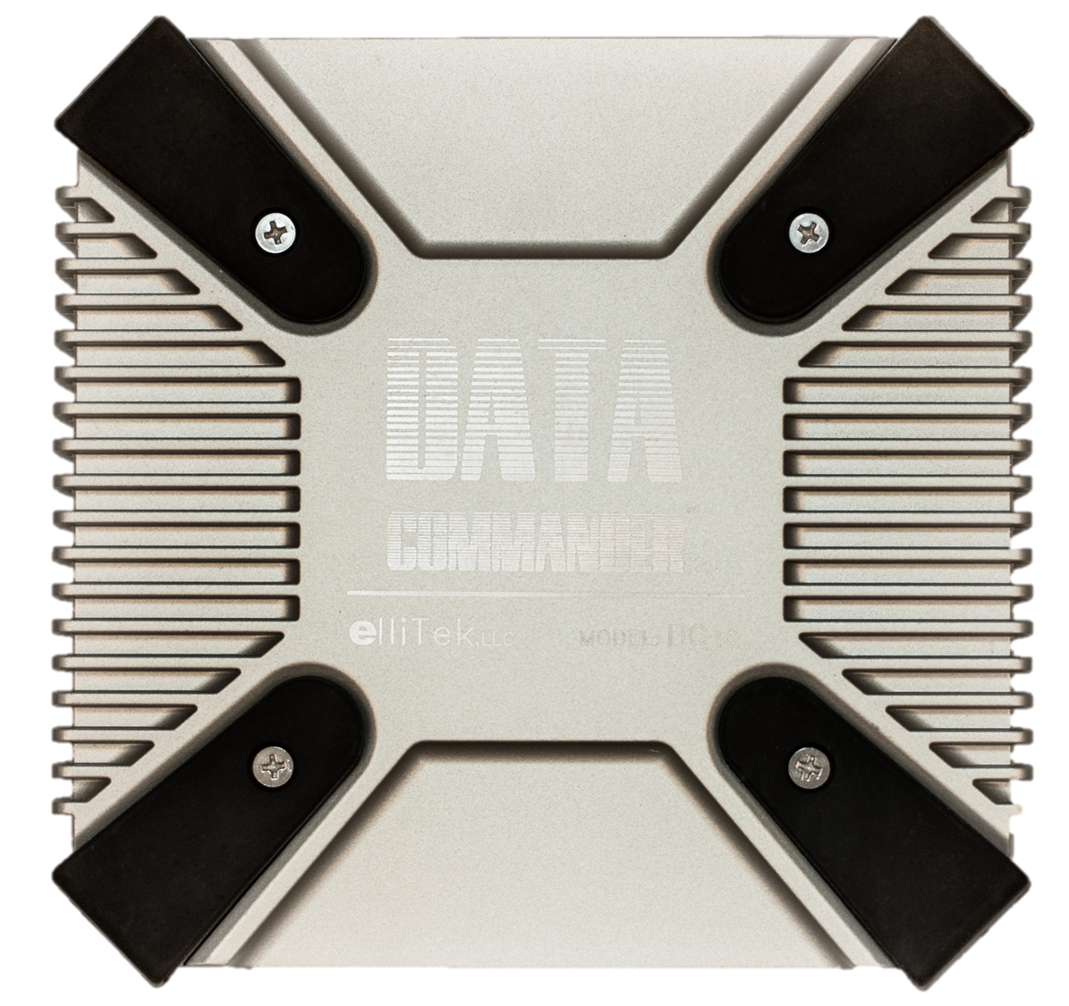
translating Industry 4.0
Data Commander™ MES Gateway Appliance
Notes:
Personal introduction:
Hi, my name is Keary Donovan. My background is in motion control and management information systems. I’m here with you today to present educational information about how to translate production’s data collection for exchange with databases in the office that evaluate manufacturing’s processes.

Slide 2
#otmesit
Questions and Answers
Notes:
For Q&A during the presentation, use our hashtag #OTMESIT on Twitter for ongoing conversations.

Slide 3
OT
IT
Roles - Stake Holders of
Data Exchange
Machine Availability vs Network Security
Appliances vs Industrial PCs
Notes:
Our presentation is about how the Data Commander as an MES gateway appliance simplifies the deployment of Industry 4.0/Smart Manufacturing. Data Collection is simplified by addressing the organizational conflicts as well as the technological obstacles.
The three stake holders in data exchange are: Engineering, IT, and Manufacturing Process Managers. Understanding their roles and their responsibilities helps illustrate the problems manufacturers have had exchanging data with the factory floor.
Manufacturing’s component and software suppliers have been convincing Manufacturing Process Managers to converge the OT and IT disciplines. Convergence is a solution that creates its own problems.
Our goal is to educate decision makers and users about how an MES gateway appliance solves the inherent flaws of industrial PCs being used to converge OT with IT systems. We isolate OT and IT systems to exchange production data.

Slide 4
4th Industrial Revolution
IIoT as evolution vs revolution.
Notes:
Our workshop is going to teach how an MES gateway appliance will radically simplify Smart Manufacturing deployment.
Who’s ready for the next big thing? Who would like to see the payback on their investment from the last big thing?
IoT is not necessarily a new concept. It used to be called telemetry or data acquisition or supervisory control. Very few in industry plan on sending their proprietary sensor data to the cloud instead of to a machine’s PLC, but there is profitable opportunity in Smart Manufacturing. Manufacturers can use their existing technology to improve monitoring and control, and deploy manufacturing’s data communications more broadly… if it were connected correctly.
A dedicated MES gateway appliance used to connect manufacturing’s Operations Technology (OT) with administration’s Information Technology (IT) eliminates PCs and OPC middleware from the factory floor, and all of the complex and compromising connection issues that come with them.

Slide 5
management
MES - Manufacturing Execution Systems
Notes:
How many managers are in the audience?
Manager’s, I want you to be honest with yourself - did your pulse beat a little faster at the site of a dashboard? I mean c’mon, it’s all of product development and production analysis at your fingertips!
Why shouldn’t you expect production data this way? We traveled here with pocket sized devices that allow us to work anywhere we choose. Today we chose to work remotely, but we didn’t disconnect from our office while we’re here. So why is it so hard for a manager to have the same simple connection with their production floor?
PCs on the production floor are preventing the acquisition of the production data (MDA) you need to meet your goals. Engineers responsible for OT, and IT professionals responsible for system administration cannot take ownership of a PC on the production line, because of the natural conflict between the two systems' responsibilities and areas of expertise.
You may be asking how could a billion dollar automation industry, filled with talented and educated professionals, have not found an easy connection between OT and IT already, when the information is needed so badly and is so justifiable?

Slide 6
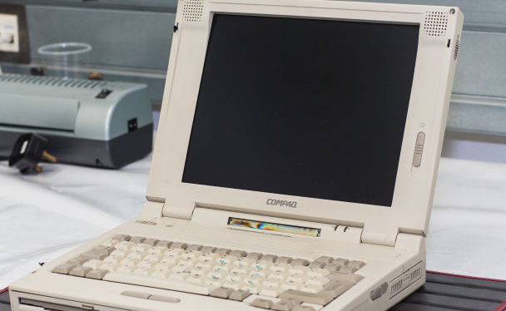
QA:Quality Assurance
Interdependent Systems
Verification & Validation
Traceability
Notes:
How many engineers are in the audience?
This is a $13M Mclaren F1 supercar. It’s controls are totally dependent on a made-to-order CA card in a Compaq LTE 5280 laptop from the early 1990s. That Compaq is running a made-to-order CA card, and if you’re lucky, you may be able to find one on eBay.
To most people, this news is an absurd story of incompetence. To engineers designing around legacy systems in process and production, it’s common place. Process and quality assurance are ensured through systematic methods to maintain defined control parameters. Once they’re in place, processes are not to be tinkered with.
All components of a production line that are passing and failing parts rely on decades of legacy automation solutions. Each device used in production is part of an interdependent system. Systematic methods maintain defined control parameters for process and quality assurance.
Any component to be added to the process must comply with the web of solutions that engineers are responsible for, and not interfere with engineers’ production QA responsibilities.

Slide 7
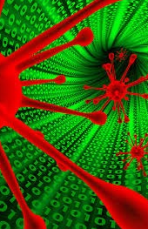
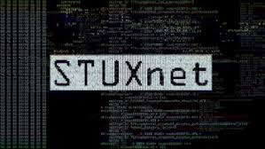
Notes:
How many IT professionals are in the audience?
In June, 2010, a tiny company in Belarus received a complaint about a software glitch. Detectives found a virus named Stuxnet. Unlike viruses and worms on the internet, this one was not trying to steal passwords, identities, or money. It crawled from computer to computer, around the world, looking for a network using a specific type of equipment - a Siemens S7 300 PLC. The virus was designed to speed up the motors that control nuclear plant centrifuges past what they’re meant to be, and damage them. Operators couldn’t see any damage because the virus was disguised from supervisory control (PC-based SCADA).
System Administrators have 2 problems: 1) dumb users 2) smart users.
Any PC in the organization is a security risk. The dominant and accepted technologies for implementing communication with the controls and automation on the production floor are 1) proprietary PC software and 2) OPC middleware. Either of these solutions are a security problem for IT because they’re responsible for every PC on their network. Any PC is a security risk and must be managed to avoid hacking and system errors.

Slide 8
 | Operations technology | Information technology
Security | Availability | Confidentiality
Change management | Scheduled in advance, Patches are negative | Timely, Patches are frequent
data | Simple, High data rate (1M msg/sec) | Complex, Low data rate (10K msg/sec)
Notes:
At this point, how likely does it seem our production managers are going to get their dashboard? No admins want the security problem of an engineers’ PC entering their IT network, and no engineers want the process and QA risk of the office’s PCs effecting machine availibility. But why? Aren’t they both hyper-diligent about the data integrity of their networks?
Both disciplines manage security, change management, and their data differently, and the expertise of one is in direct conflict with the expertise of the other.
Security in OT means making sure the production is always available and online. Security in IT means total and complete confidentiality.
Changes in OT are discouraged and infrequent. When changes are required, they’re scheduled a long-time in advance to plan production accordingly. IT must make constant, and immediate security patches to protect the network.
OT’s ON/OFF machine data is simple, but runs at an extremely high rate to coordinate production processes in real-time. IT’s data consists of complex operating systems and updates that run at low data rates in comparison to OT’s.
Smart Manufacturing has been made difficult because companies are trying to converge systems that should be isolated from each other.

Slide 9
Point-and-click workshop
Brandon Ellis M.E., Data Commander Inventor
Notes:
Now, we’re going to demonstrate how to exchange data between a Rockwell PLC and a SQL database. The demonstration is of a point and click interface that talks natively in the PLC language/protocol and the SQL programming languages. We will reduce a typical months-long project down to minutes. Please use the chat window (or Twitter #OTMESIT) to present your questions for our Q&A session afterwards.
Thank you for your attention, and now please welcome Brandon Ellis, our engineer and inventor of the Data Commander MES gateway appliance.

Slide 10
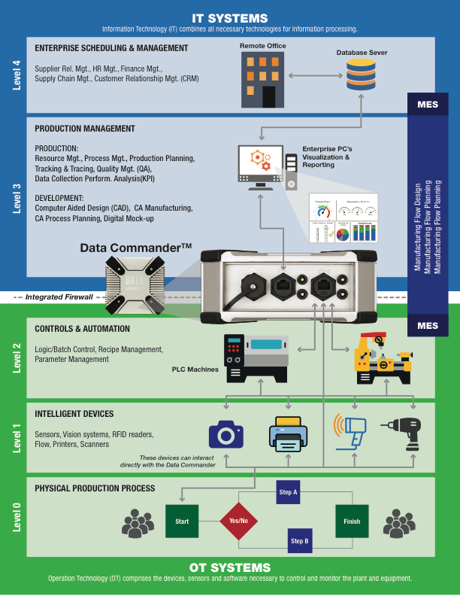
Notes:
Rather than packets of data being able to go from one network to another like a router, an appliance running a single application like our MES gateway appliance doesn’t pass data through unless the fields are mapped between the two networks using the custom application.

